Slide 1
Student Management System

Slide 2
Name: BN:
Ibrahim Ali 1
Ahmed Gamal 3
Ahmed Hamdy 4
Aya Osama 13
Bassant Amr 14

Slide 3
User of System
Role of User
▸Admin
▸Access Data of student
▸Access Data of subject
▸Access Data of teacher
(CURD)

Slide 4
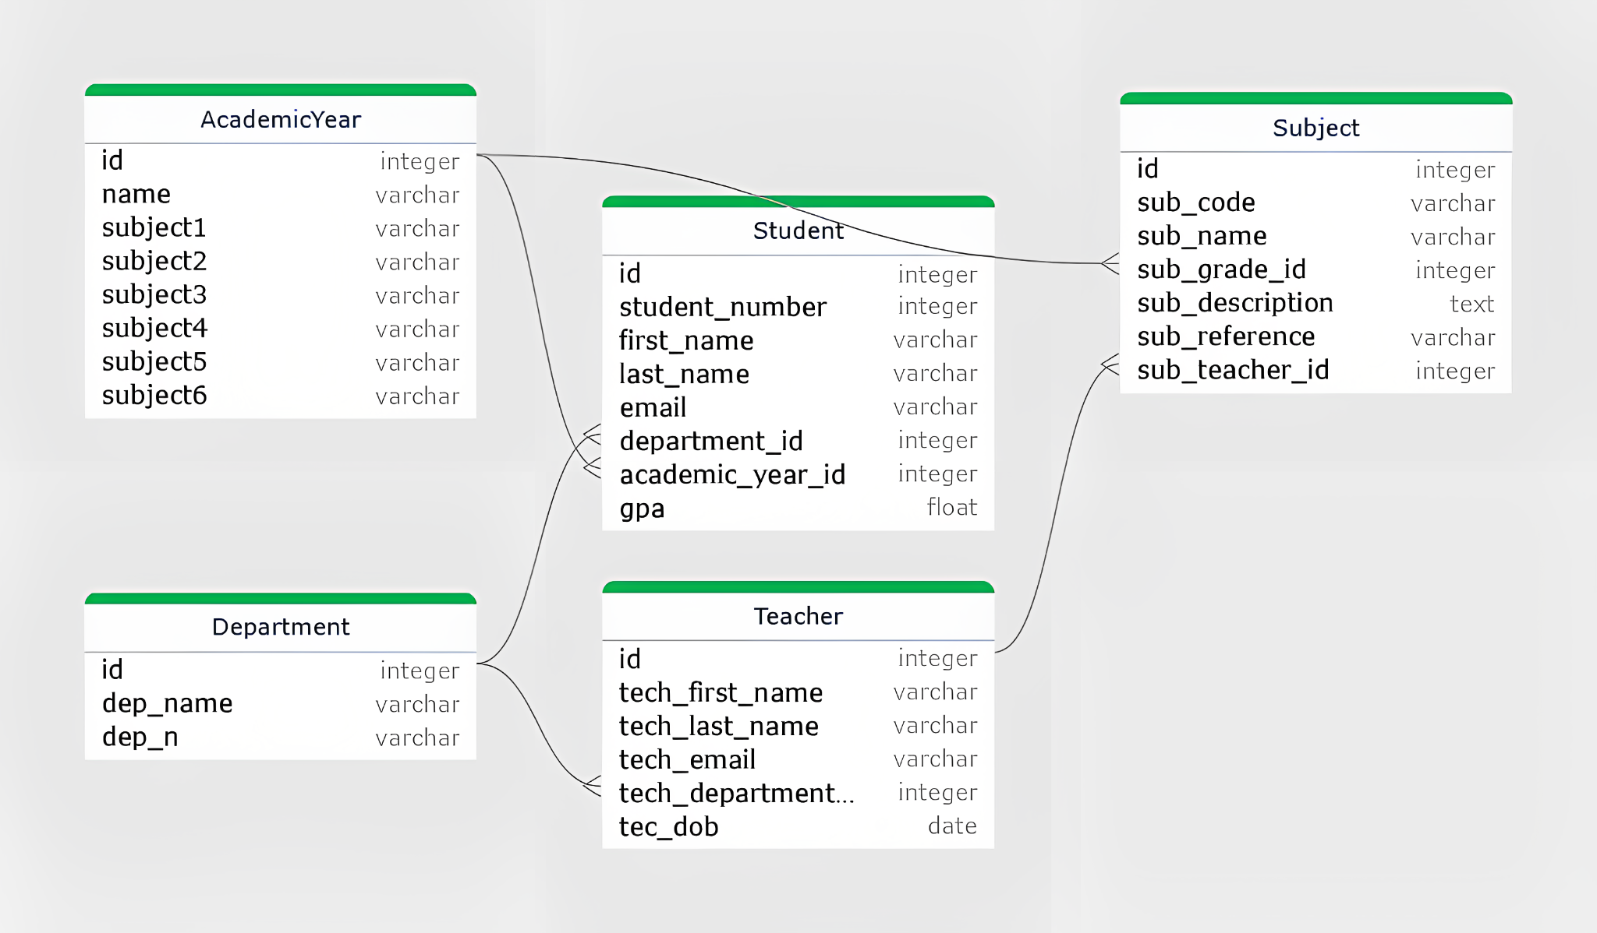
ERD

Slide 5
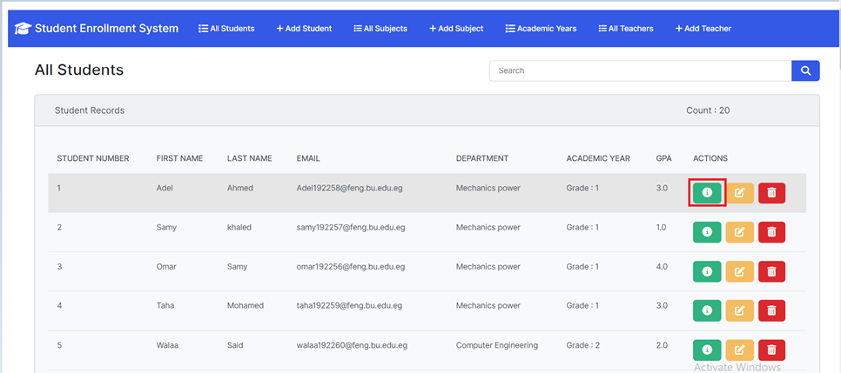
Show Student record

Slide 6
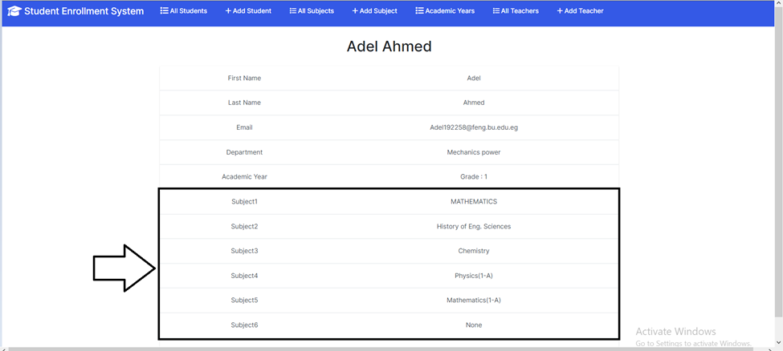

Slide 7
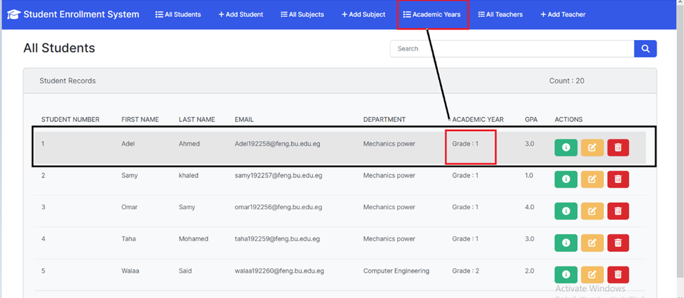
show subject of Academic year

Slide 8
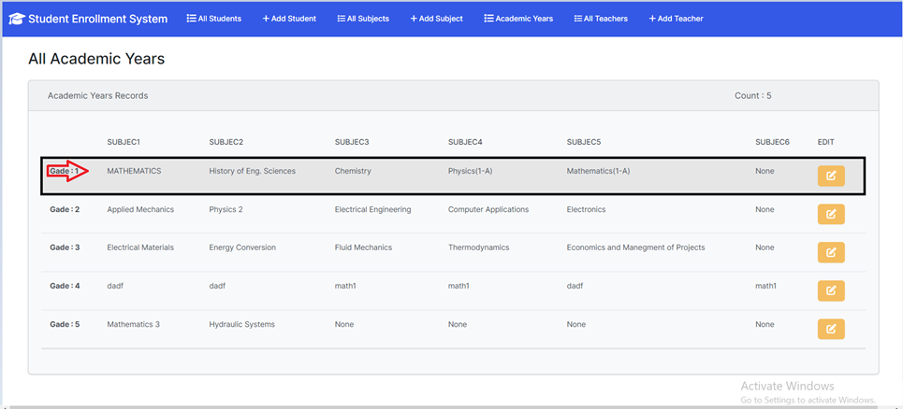

Slide 9
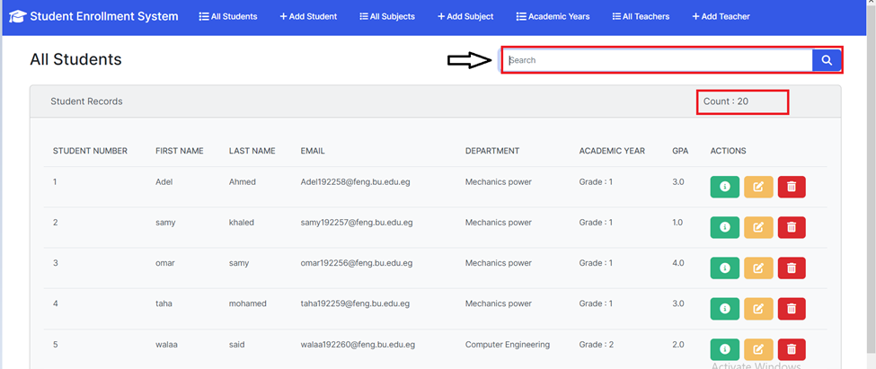
Search For Record

Slide 10
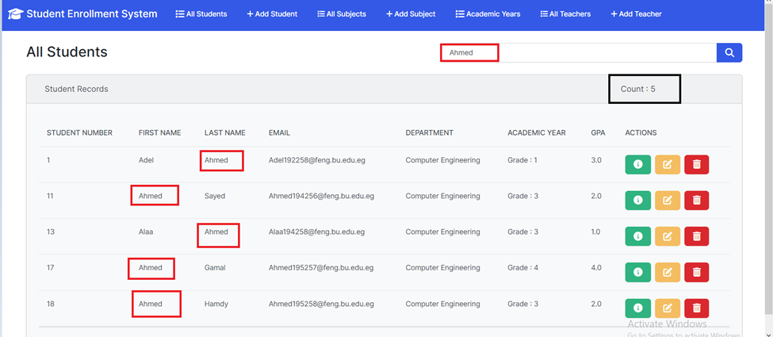

Slide 11
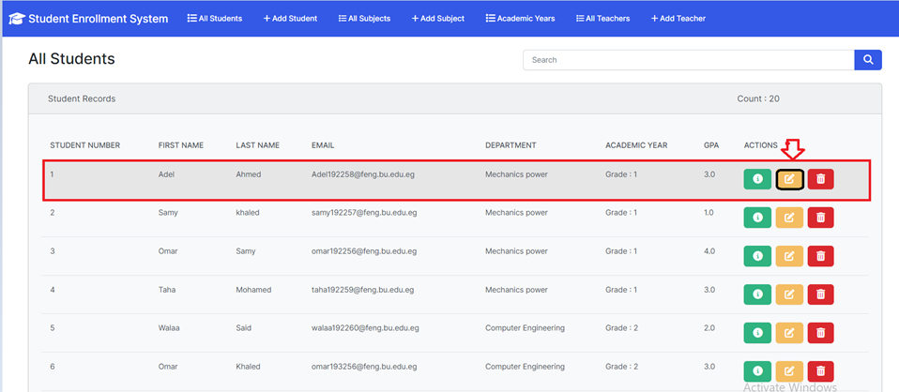
Edit Student Record

Slide 12
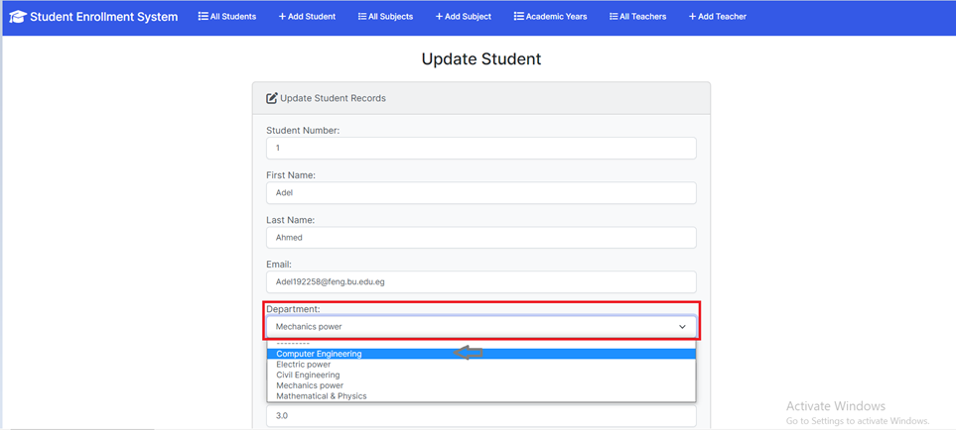

Slide 13
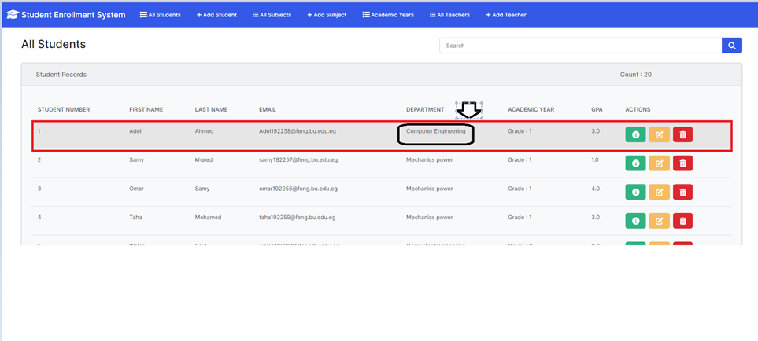

Slide 14
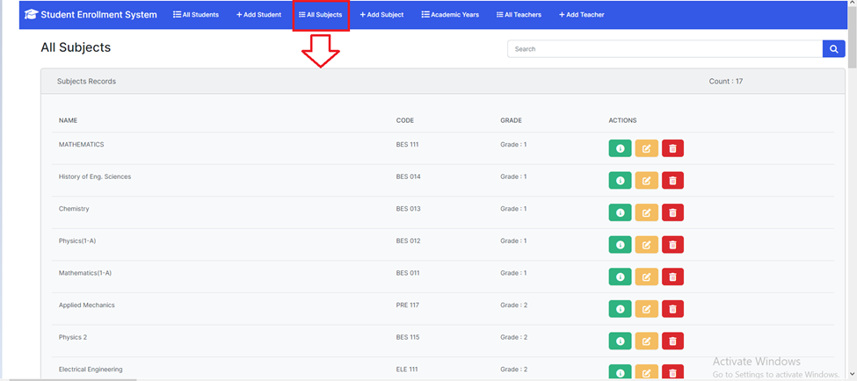
Show All Subjects

Slide 15
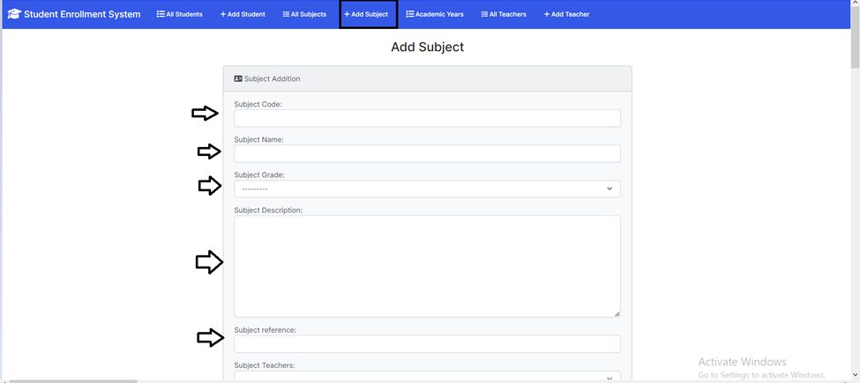
Add Subject

Slide 16
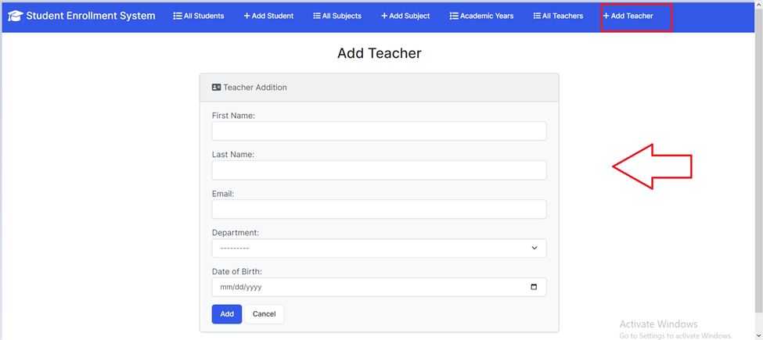
Add Teacher

Slide 17
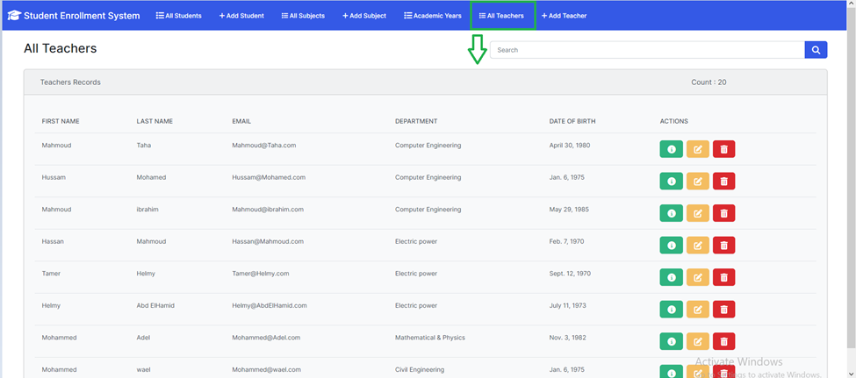
Show All Teacher

Slide 18
Update Student record

Slide 21
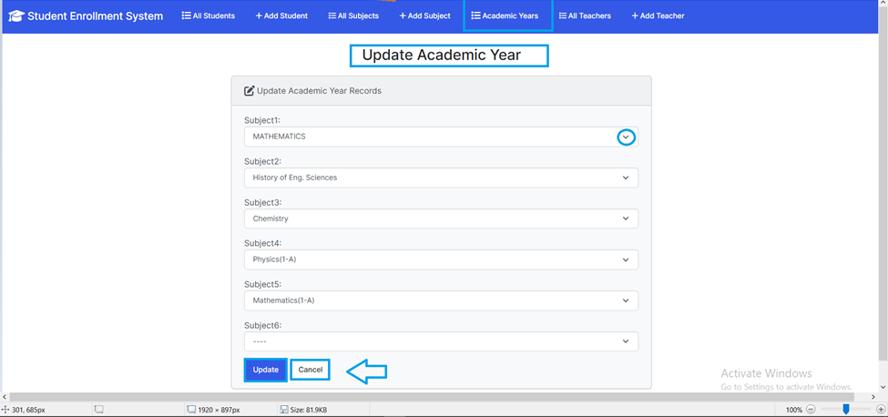
Update Academic year

Slide 22
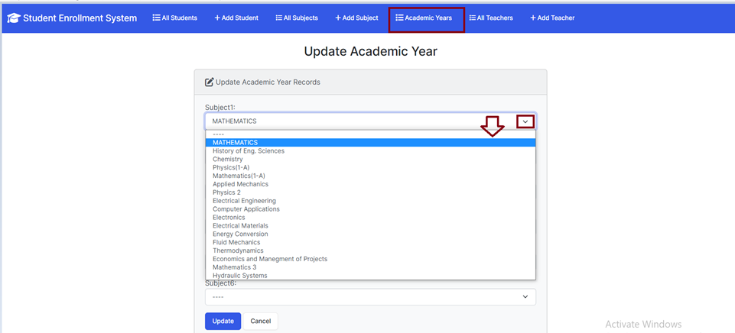

Slide 23
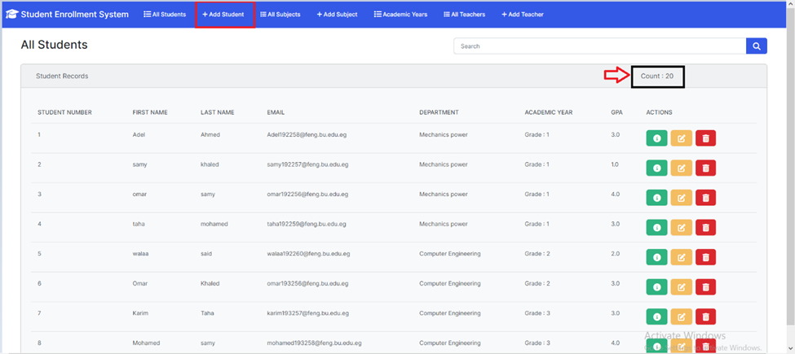
ADD student

Slide 24
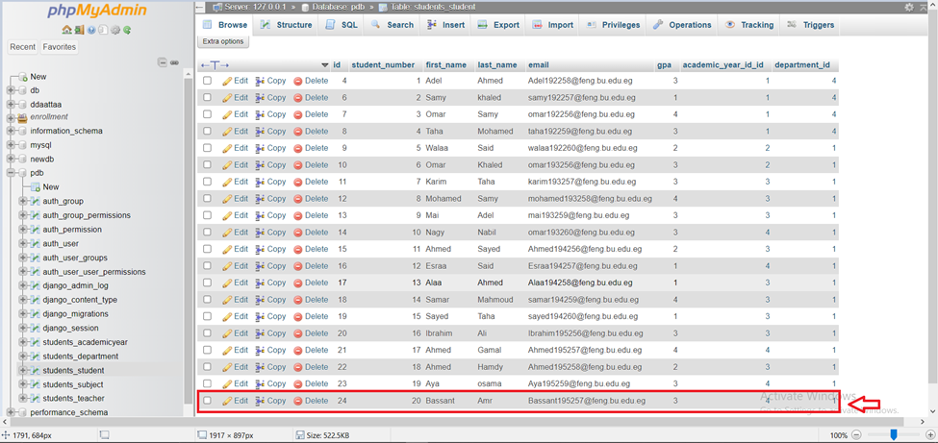

Slide 25
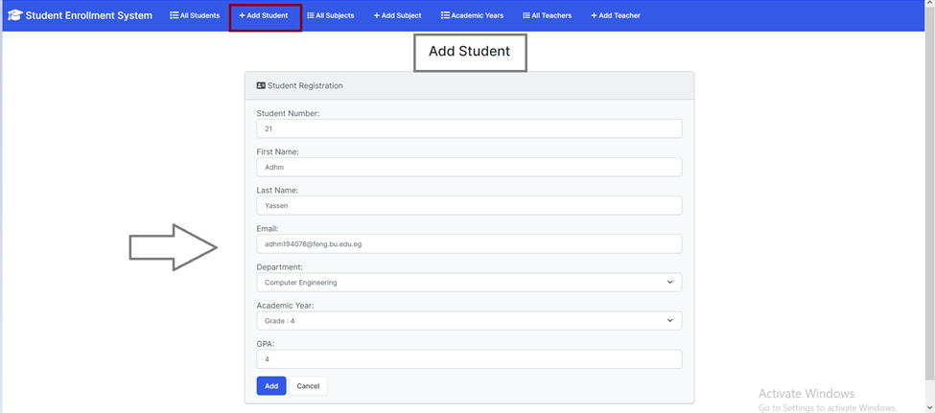

Slide 26

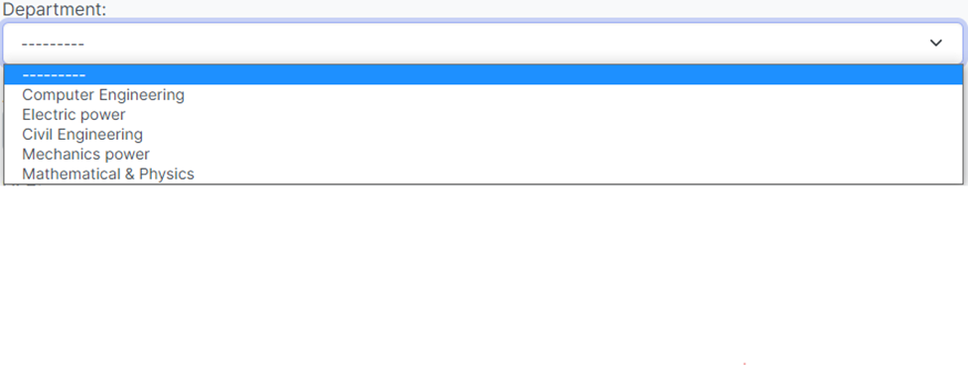

Slide 27


Slide 28
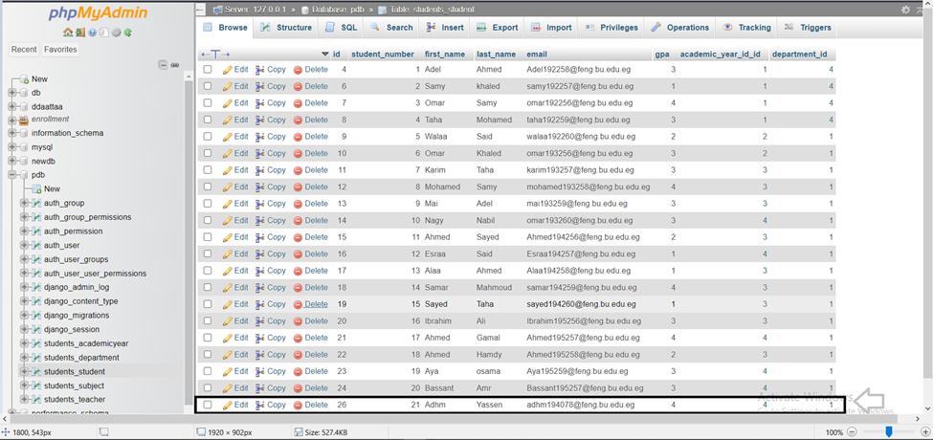

Slide 29
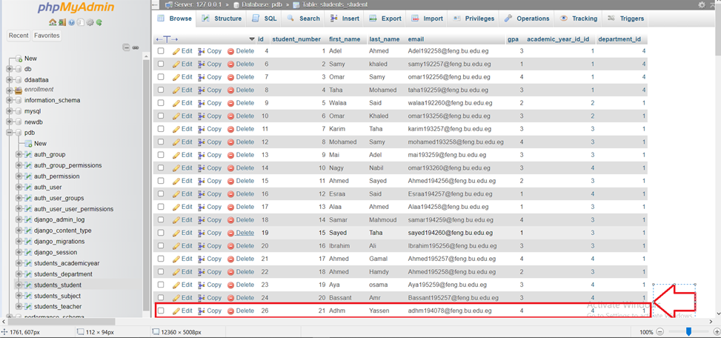
Delete Record

Slide 30
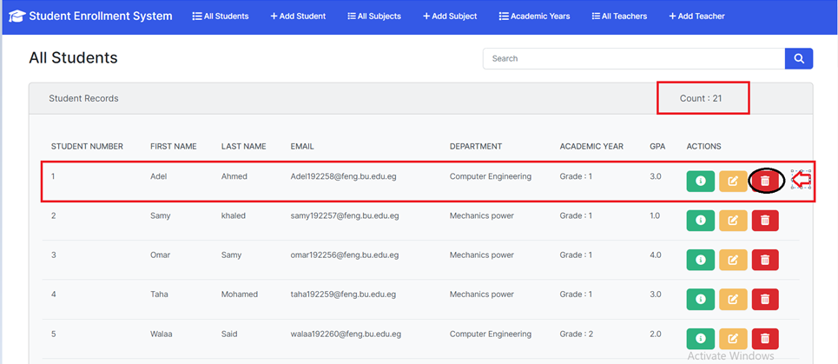

Slide 31
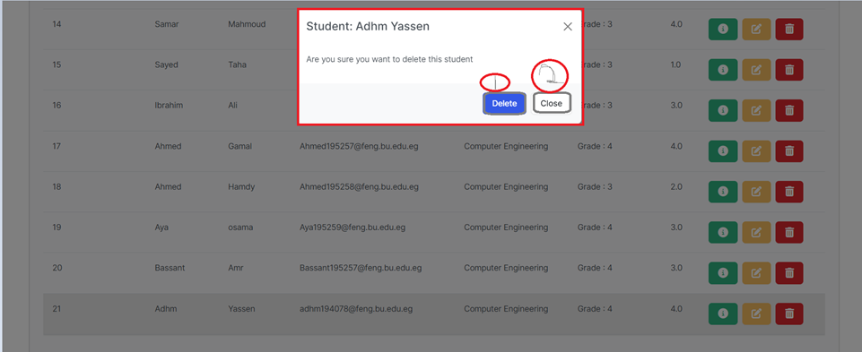

Slide 32

